Slide 1

Climate Data Archival and Analysis System with Compressed Time-Series Storage
by Eleanya Ude
For CS 4525
All resources and code are available at: https://github.com/ud204/climateArchiv_AdvDatabase_Project

Slide 2

Project Description
Data Management
Analysis
Store and compress climate data from weather stations using advanced techniques.
Enable trend analysis and anomaly detection on compressed time-series data.
Visualization
Provide tools for climate researchers to visualize data and trends.

Slide 3
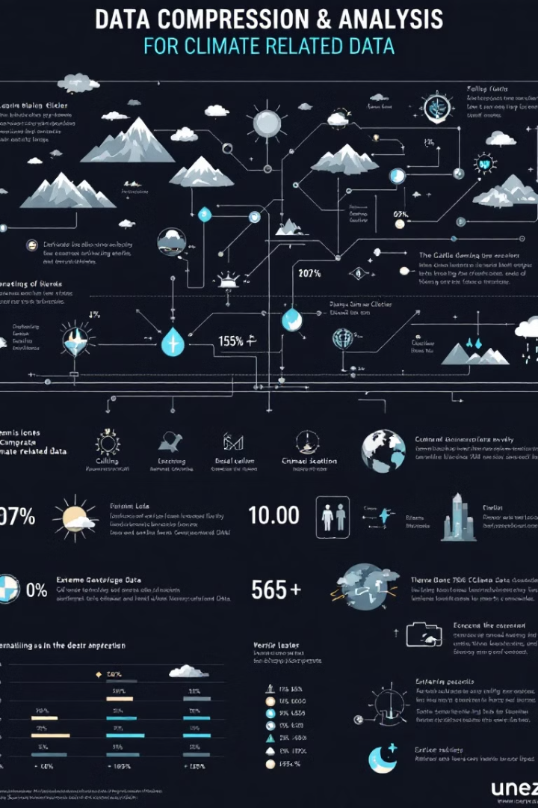
Objectives
1
Efficient Data Storage
Optimize storage of large-scale time-series climate data using compression techniques.
2
Time-Series Data Management
Implement a database with advanced indexing for fast querying.
3
Data Analysis and Visualization
Enable trend analysis, anomaly detection, and provide tools for visualizing climate trends.
4
Scalability
Handle increasing data volumes from multiple weather stations.

Slide 4





Key Features
Data Collection
Compression
Store climate metrics in a structured format.
Use delta encoding and run-length encoding techniques.
Indexing
Analysis and Visualization
Implement B+-tree for efficient range queries.
Enable aggregation queries and provide interactive visualization tools.

Slide 5
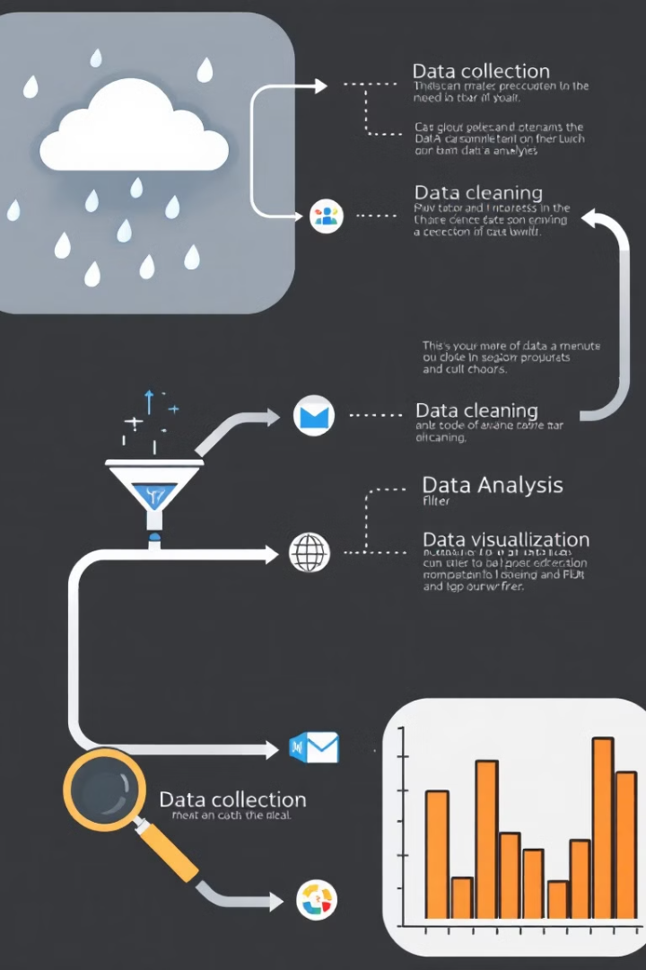




System Workflow
Data Ingestion
Upload and preprocess climate data from various sources.
Data Storage
Compress and store data with efficient indexing methods.
Analysis
Perform real-time trend analysis and detect anomalies.
Visualization
Present results through interactive dashboards for monitoring climate data.

Slide 6
Technology Stack
Backend
Frontend
Analysis
Python
JavaScript
Pandas
SQLite
HTML and CSS
SciPy
Compression libraries
TensorFlow

Slide 7
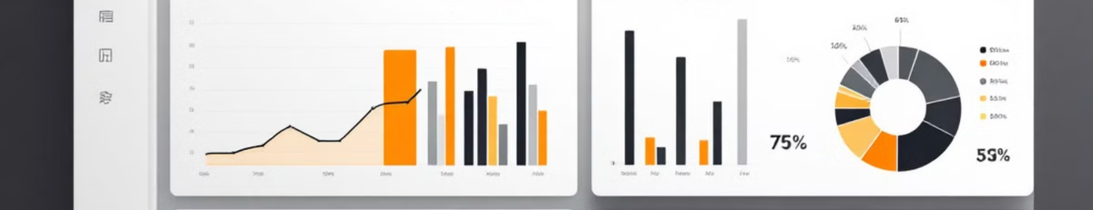
Expected Deliverables
1
Database
2
API
Compressed time-series database for efficient climate data storage.
Interface for data ingestion and retrieval operations.
3
Compression Module
4
Visualization Dashboard
Optimized storage solution for time-series climate data.
Interactive tools for exploring and analyzing climate data.

Slide 8

Challenges
Query Performance
Ensuring fast queries on compressed data
Compression Balance
Optimizing compression ratios vs. decompression speed
Data Variability
Handling edge cases with highly variable climate data
Real-time Updates
Integrating live data streams into the database

